Slide 1




AREA II:
LAND AND WATER RESOURCES ENGINEERING
Prepared by: Engr. Nicole Jane J. Lim
ABELE | 2025
ATTRC - Iligan City

Slide 2
IRRIGATION AND DRAINAGE ENGINEERING
Surveying
Pumps
Fluid Mechanics
Open Channel
Groundwater Hydrology
Pressurized Irrigation Systems

Slide 3
IRRIGATION AND DRAINAGE ENGINEERING
Surveying
Pumps
Fluid Mechanics
Open Channel
Groundwater Hydrology
Pressurized Irrigation Systems

Slide 4
Surveying
Pumps
OPEN CHANNEL
Fluid Mechanics
Groundwater Hydrology
Pressurized Irrigation Systems

Slide 5
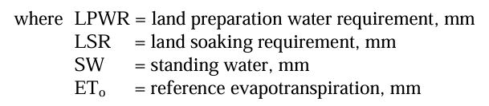
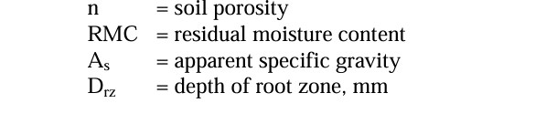
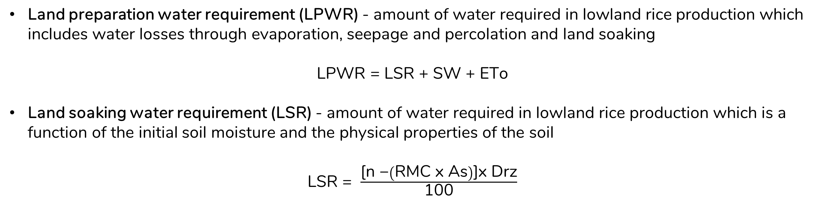
IRRIGATION WATER REQUIREMENT AND RELATED FORMULAS
Land preparation water requirement (LPWR) - amount of water required in lowland rice production which includes water losses through evaporation, seepage and percolation and land soaking
LPWR = LSR + SW + ETo
Land soaking water requirement (LSR) - amount of water required in lowland rice production which is a function of the initial soil moisture and the physical properties of the soil
LSR = $\frac{\text{[}\text{n}\text{ −}\left(\text{RMC} \text{x} \text{As}\right)\text{]}\text{x} \text{Drz}}{\text{100}}$
Reference: PAES 602:2016
ATTRC ABELE Review 2025
Irrigation and Drainage Engineering | Open Channel

Slide 6
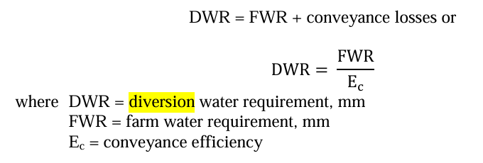
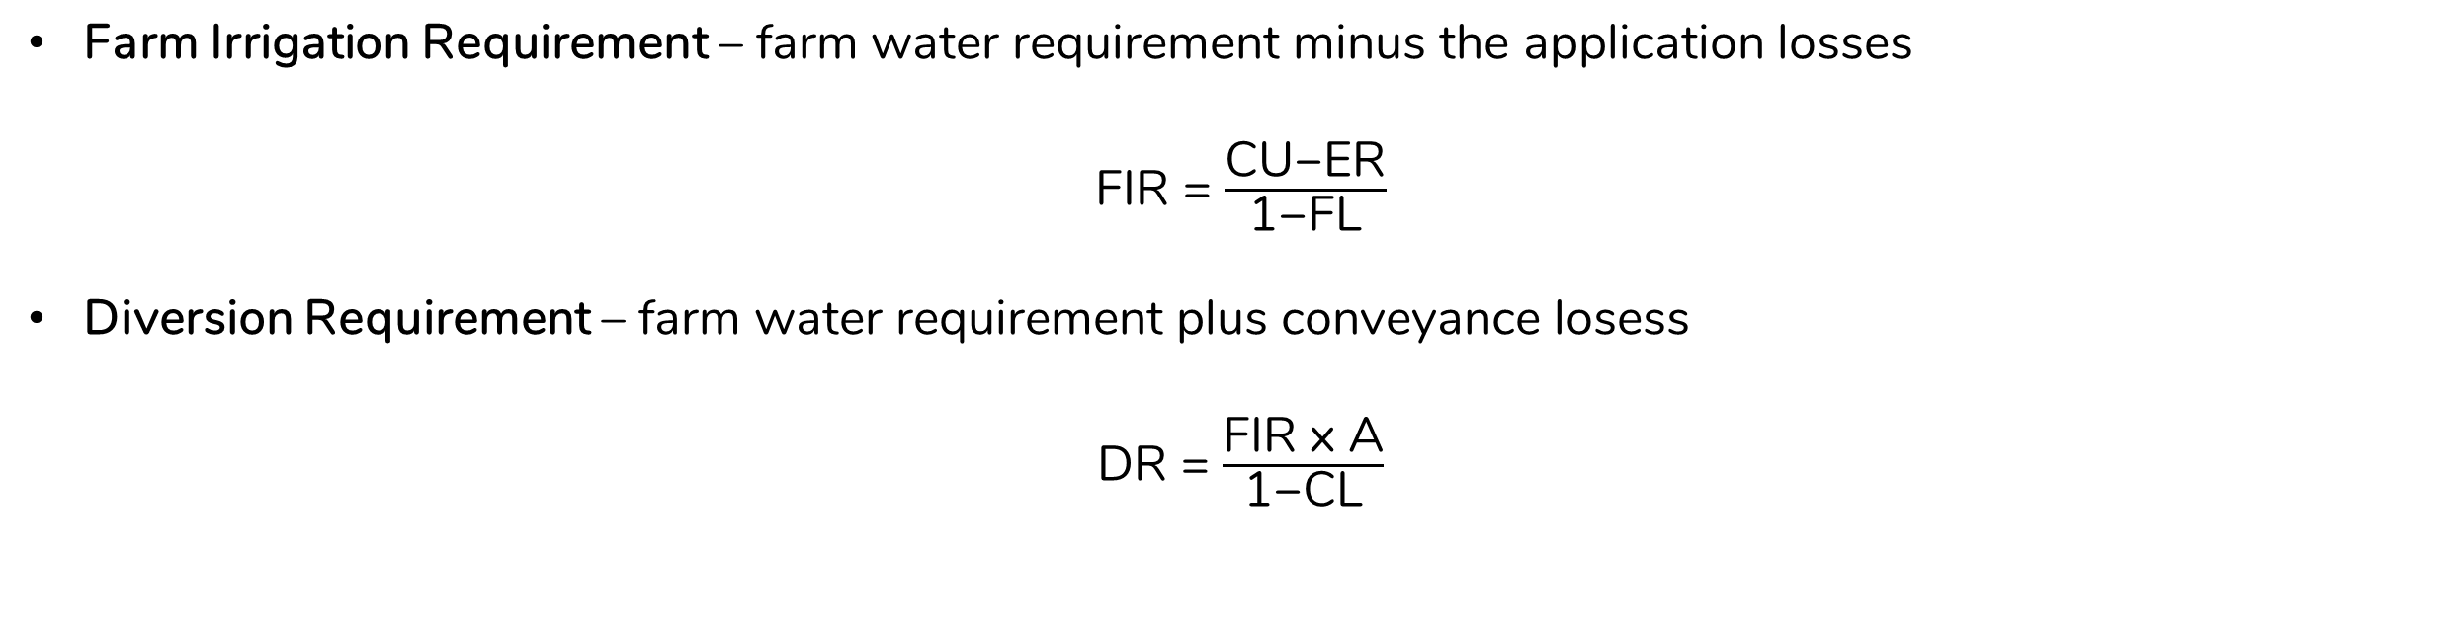
IRRIGATION WATER REQUIREMENT AND RELATED FORMULAS
Farm Irrigation Requirement – farm water requirement minus the application losses
FIR = $\frac{\text{CU}\text{−}\text{ER}}{\text{1−}\text{FL}}$
Diversion Requirement – farm water requirement plus conveyance losess
DR = $\frac{\text{FIR} \text{x} \text{A}}{\text{1−}\text{CL}}$
Reference: PAES 602:2016
ATTRTC ABELE Review 2024
ATTRC ABELE Review 2025
Irrigation and Drainage Engineering | Open Channel
Irrigation and Drainage Engineering | Open Channel

Slide 7

IRRIGATION APPLICATION AND SCHEDULING
Depth of Irrigation
Based on field capacity and available moisture prior to irrigation
d = $\frac{\left(\text{FC}\text{ − }\text{AM}\right)\text{D}}{\text{Ea}}$
Irrigation Interval
II = $\frac{\text{p} \text{x} \text{AM} \text{x} \text{D}}{\text{(}\text{ET}\text{ − }\text{ER}\text{)(}\text{Ea}\text{)}}$
where: FC = field capacity
AM = available moisture prior to irrigation
D = depth of rootzone
Ea = application efficiency
p = fraction of available soil water that permits unrestricted ET
ET = evapotranspiration
ER = effective rainfall
Reference: https://www.sciencedirect.com/book/9780750659789/hydraulics-of-open-channel-flow
ATTRTC ABELE Review 2024
ATTRC ABELE Review 2025
Irrigation and Drainage Engineering | Open Channel
Irrigation and Drainage Engineering | Open Channel

Slide 8
IRRIGATION EFFICIENCY
Water conveyance efficiency – ratio of water delivered to water diverted
Water application efficiency – ratio of water stored in the root zone to water delivered to the farm
Water-use efficiency – ratio of water beneficially used to water delivered
Water storage efficiency – ratio of water stored in the root zone during irrigation to water needed in the root zone prior to irrigation
Consumptive use efficiency – ratio of normal consumptive use to the net amount of water depleted from root zone
Water distribution efficiency – ratio of the average numerical deviation in depth stored during irrigation to the average depth of water stored during irrigation
Reference: https://www.sciencedirect.com/book/9780750659789/hydraulics-of-open-channel-flow
ATTRTC ABELE Review 2024
ATTRC ABELE Review 2025
Irrigation and Drainage Engineering | Open Channel
Irrigation and Drainage Engineering | Open Channel

Slide 9
TIP
UNDERSTANDING
RATHER THAN
MEMORIZING

Slide 10
QUESTION
Twelve thousand two hundred fifty cubic meters of water was delivered to a 10-ha farm for the month of June in which consumptive use is estimated at 8mm/day. The effective rainfall for the period was 150mm. What is the irrigation efficiency?
Ans. 73%
ATTRTC ABELE Review 2024
ATTRC ABELE Review 2025
Irrigation and Drainage Engineering | Open Channel
Irrigation and Drainage Engineering | Open Channel
Notes:
IE = [(CU x 30 days) – ER]/water delivered

Slide 11
QUESTION
Evapotranspiration in an 8 ha farm is 7 mm/day and percolation losses is 2 mm/day. What is the design discharge of a canal to be able to deliver a 5-day requirement of the farm in 24 hours if irrigation efficiency is 75%?
Ans. 200m³/hr
ATTRTC ABELE Review 2024
ATTRC ABELE Review 2025
Irrigation and Drainage Engineering | Open Channel
Irrigation and Drainage Engineering | Open Channel
Notes:
Q = [(ET + P) x 5 days x 8 x 10000]/24h x 0.75

Slide 12
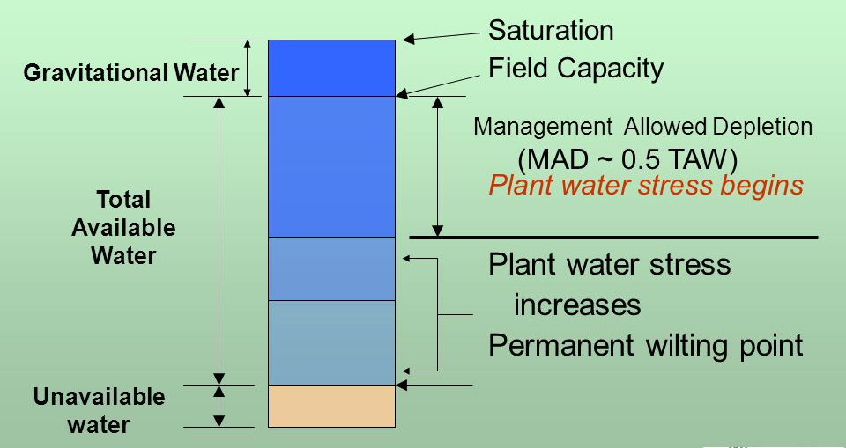
QUESTION
Determine the irrigation interval for a farm with soil root zone having a field capacity of 200 mm and a wilting point of 105 mm. Assume that the consumptive use for August is 7.5 mm/day with no rainfall and the allowable moisture depletion is 75%.
Ans. 9 days
ATTRTC ABELE Review 2024
ATTRC ABELE Review 2025
Irrigation and Drainage Engineering | Open Channel
Irrigation and Drainage Engineering | Open Channel
Notes:
II = [(FC-PWP) x MAD]/CU

Slide 13
QUESTION
What is the design discharge of a canal to be able to deliver 7-day requirement of a 5-ha farm in 12 hours if the irrigation requirement is 8mm/day?
Ans. 233.33m³/hr or 0.065m³/s
ATTRTC ABELE Review 2024
ATTRC ABELE Review 2025
Irrigation and Drainage Engineering | Open Channel
Irrigation and Drainage Engineering | Open Channel

Slide 14

QUESTION
Compute the land soaking requirement for a soil (depth of root zone = 60 cm) with residual moisture content of 18% by weight, bulk density of 1,320 kg/m³ and porosity of 50%. Standing water for planting is 20 mm.
Ans. 157.44mm
ATTRTC ABELE Review 2024
ATTRC ABELE Review 2025
Irrigation and Drainage Engineering | Open Channel
Irrigation and Drainage Engineering | Open Channel

Slide 15
QUESTION
What is the root zone depth of a farm with land soaking requirement of 90 mm if the soil porosity is 45%, residual moisture content is 18% (by weight) and bulk density is 1,250 kg/m³?
Ans. 400mm
ATTRTC ABELE Review 2024
ATTRC ABELE Review 2025
Irrigation and Drainage Engineering | Open Channel
Irrigation and Drainage Engineering | Open Channel

Slide 16
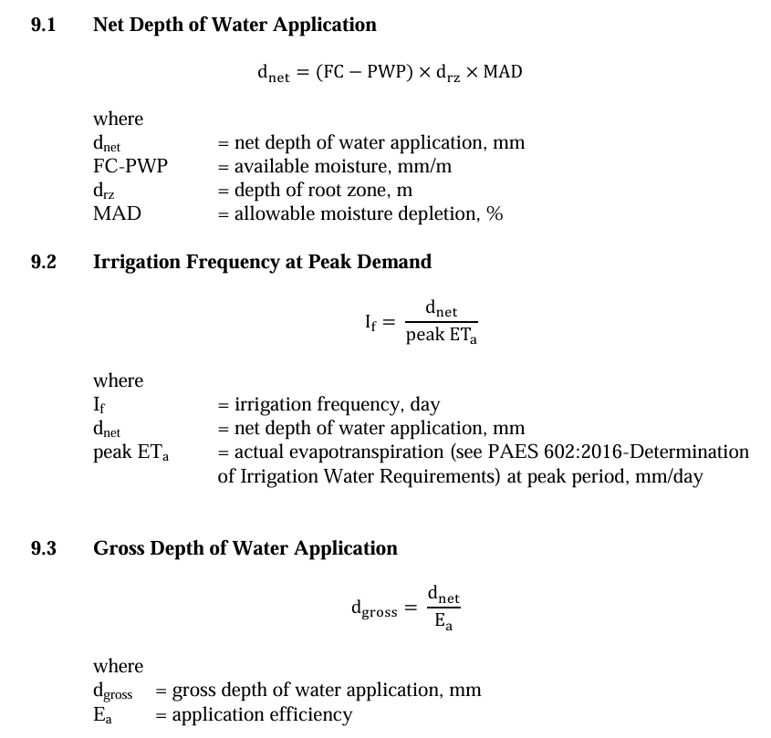
QUESTION
In a 5 ha area, it was determined that the soil volumetric field capacity and permanent wilting point are 25% and 15%, respectively. Crop consumptive use is 5 mm/day, application efficiency is 80% and irrigation application rate is 60 m³/hr. The allowable soil moisture depletion is 60%, apparent specific gravity is 1.2 and the depth of root zone is 0.8 m. Determine the following: a) d_{net} b) d_{gross}
Ans. a) 48mm
b) 60mm
ATTRTC ABELE Review 2024
ATTRC ABELE Review 2025
Irrigation and Drainage Engineering | Open Channel
Irrigation and Drainage Engineering | Open Channel

Slide 17
QUESTION
In a 5 ha area, it was determined that the soil volumetric field capacity and permanent wilting point are 25% and 15%, respectively. Crop consumptive use is 5 mm/day, application efficiency is 80% and irrigation application rate is 60 m³/hr. The allowable soil moisture depletion is 60%, apparent specific gravity is 1.2 and the depth of root zone is 0.8 m. Determine the following: c) irrigation interval d) irrigation period
Ans. c) 9 days
d) 50 hours
ATTRTC ABELE Review 2024
ATTRC ABELE Review 2025
Irrigation and Drainage Engineering | Open Channel
Irrigation and Drainage Engineering | Open Channel

Slide 18
QUESTION
Surface irrigation method where a much smaller area is enclosed by levees
Border strip irrigation
Basin flooding
Trickle irrigation
Furrow irrigation
Reference: https://www.usgs.gov/faqs/what-groundwater
ATTRTC ABELE Review 2024
ATTRC ABELE Review 2025
Irrigation and Drainage Engineering | Open Channel
Irrigation and Drainage Engineering | Open Channel

Slide 19
IRRIGATION METHODS
Surface Irrigation Method
Sprinkler Irrigation Method
Sub irrigation ang Drip Irrigation Method
Reference: https://www.sciencedirect.com/book/9780750659789/hydraulics-of-open-channel-flow
ATTRTC ABELE Review 2024
ATTRC ABELE Review 2025
Irrigation and Drainage Engineering | Open Channel
Irrigation and Drainage Engineering | Open Channel

Slide 20
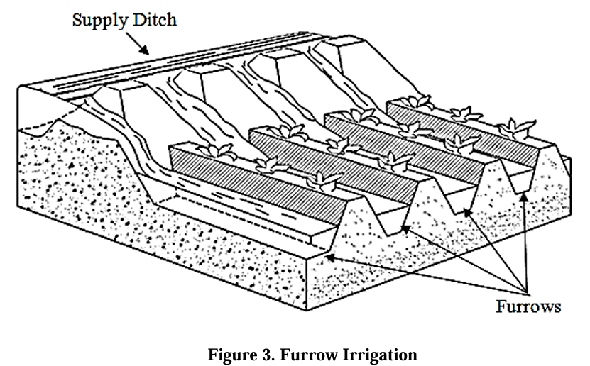
IRRIGATION METHODS
Surface Irrigation Methods
Basin irrigation - most common form of surface irrigation, particularly in regions with layouts of small fields. If a field is level in all directions, is encompassed by a dyke to prevent runoff, and provides an undirected flow of water onto the field, it is herein called a basin.
Border strip irrigation - water is applied to individual borders from small hand-dug checks from the field head ditch. When the water is shut off, it recedes from the upper end to the lower end.
Furrow irrigation - widely used for irrigation of row crops. Corrugations or small furrows are simply narrow ditch between rows of crops with about 0.2 to 0.5 of surface area wetted during irrigation. Water infiltrates through the wetted perimeter and spreads vertically and horizontally to refill the soil reservoir.
Reference: https://www.fao.org/4/t0231e/t0231e04.htm
ATTRTC ABELE Review 2024
ATTRC ABELE Review 2025
Irrigation and Drainage Engineering | Open Channel
Irrigation and Drainage Engineering | Open Channel

Slide 21
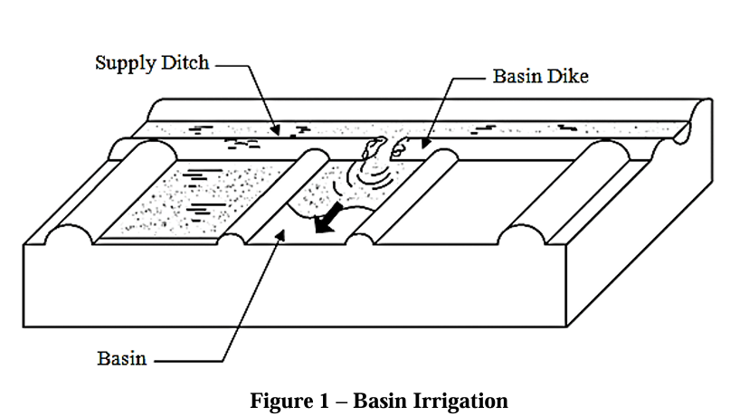
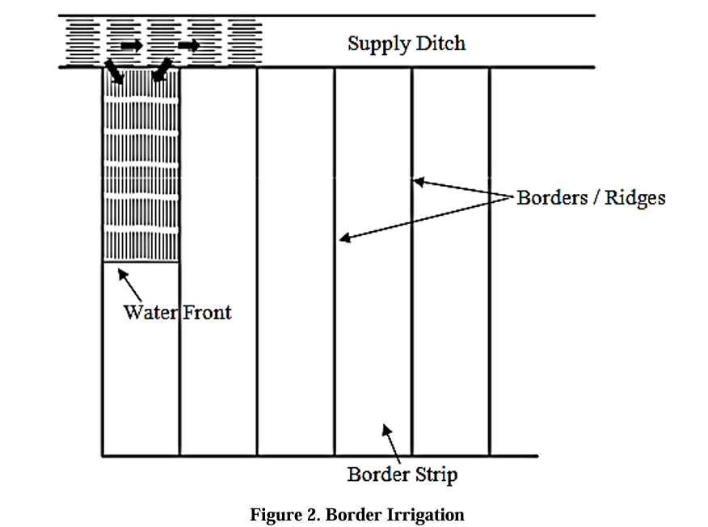
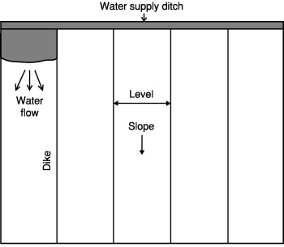
Reference: PAES 607:2016
ATTRTC ABELE Review 2024
ATTRC ABELE Review 2025
Irrigation and Drainage Engineering | Open Channel
Irrigation and Drainage Engineering | Open Channel

Slide 22
IRRIGATION METHODS
2. Sprinkler irrigation – application of water in the form of spray over the land
3. Sub irrigation and Drip irrigation Method
Sub irrigation – applying water to the soil directly under the ground surface
Drip irrigation – also trickle irrigation. Allows frequent or slow application of water either directly on land surface or into the root zones of crops
Drip or trickle irrigation is considered the most efficient irrigation method.
Reference: https://www.sciencedirect.com/book/9780750659789/hydraulics-of-open-channel-flow
ATTRTC ABELE Review 2024
ATTRC ABELE Review 2025
Irrigation and Drainage Engineering | Open Channel
Irrigation and Drainage Engineering | Open Channel

Slide 23
QUESTION
The water is directed to the base of the plant. Water is applied to the soil through small orifices .
The surface is rarely wet since the water is supplied from the soil underneath. This requires complete control of the water table so that the root zone is kept relatively free of excess water but is continually supplied with capillary moisture during the cropping season.
It is accomplished by running water through small channels or furrows while it moves down or across the slope of the field.
Furrow irrigation
Sub irrigation
Drip/trickle irrigation
Reference: https://www.sciencedirect.com/book/9780750659789/hydraulics-of-open-channel-flow
ATTRTC ABELE Review 2024
ATTRC ABELE Review 2025
Irrigation and Drainage Engineering | Open Channel
Irrigation and Drainage Engineering | Open Channel

Slide 24
CONVEYANCE, DISTRIBUTION AND MANAGEMENT STRUCTURES
Headwork structures
Conveyance structures
Control structures
Protective structures
Reference: https://www.sciencedirect.com/book/9780750659789/hydraulics-of-open-channel-flow
ATTRTC ABELE Review 2024
ATTRC ABELE Review 2025
Irrigation and Drainage Engineering | Open Channel
Irrigation and Drainage Engineering | Open Channel

Slide 25
QUESTION
It refers to the composite parts of the irrigation system that divert water from natural bodies of water such as rivers, streams and lakes.
Headworks
Diversion canal
Channel
Headgate
Reference: https://www.bfar.da.gov.ph/wp-content/uploads/2021/03/Republic-Act-8435.pdf
ATTRTC ABELE Review 2024
ATTRC ABELE Review 2025
Irrigation and Drainage Engineering | Open Channel
Irrigation and Drainage Engineering | Open Channel

Slide 26
QUESTION
This refers to a closed conduit designed to convey canal water in full and other pressure running condition, to convey canal water by gravity under roadways , railways, drainage channels and local depressions.
Siphon
Inverted siphon
Flume
Culvert
Reference: https://www.usgs.gov/faqs/what-groundwater
ATTRTC ABELE Review 2024
ATTRC ABELE Review 2025
Irrigation and Drainage Engineering | Open Channel
Irrigation and Drainage Engineering | Open Channel

Slide 27
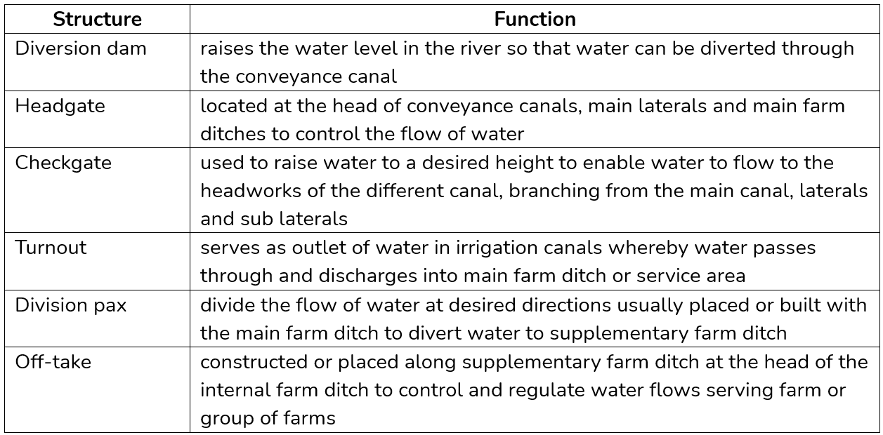
Division box
ATTRTC ABELE Review 2024
ATTRC ABELE Review 2025
Irrigation and Drainage Engineering | Open Channel
Irrigation and Drainage Engineering | Open Channel

Slide 28
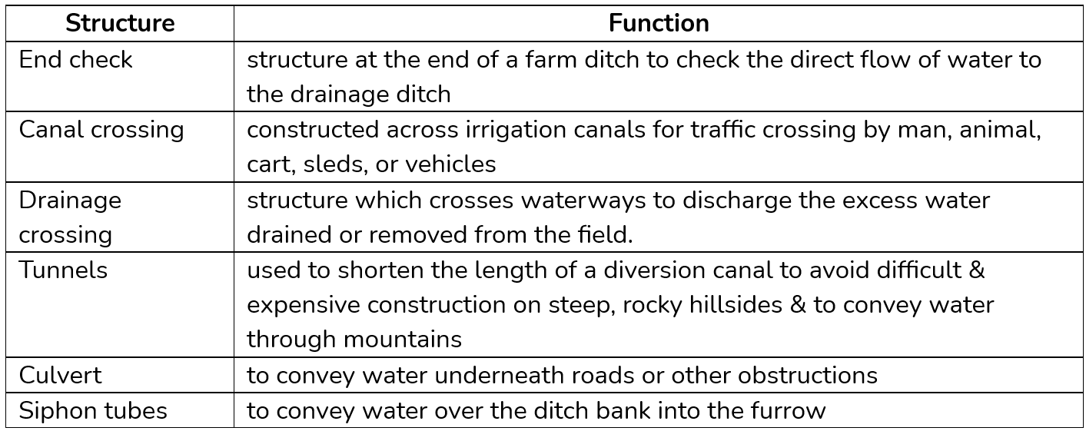
ATTRTC ABELE Review 2024
ATTRC ABELE Review 2025
Irrigation and Drainage Engineering | Open Channel
Irrigation and Drainage Engineering | Open Channel

Slide 29
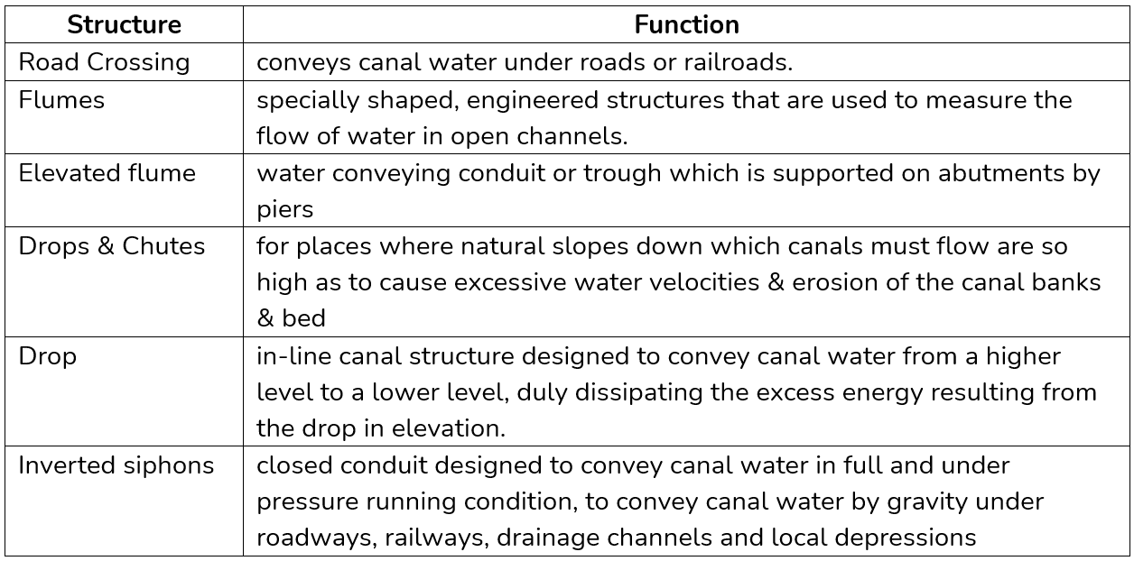
ATTRTC ABELE Review 2024
ATTRC ABELE Review 2025
Irrigation and Drainage Engineering | Open Channel
Irrigation and Drainage Engineering | Open Channel

Slide 30
QUESTION
Which of the following best describes how flow rate is related to velocity?
The volumetric flow rate is directly proportional to the velocity of the flowing fluid passing through a given cross sectional area.
The flow rate decreases as the velocity of the fluid increases in a constant cross-sectional area.
The flow rate is inversely proportional to the velocity of the fluid in a constant cross-sectional area.
The flow rate remains constant regardless of changes in the fluid velocity and cross-sectional area.
Reference: https://www.valin.com/resources/blog/introduction-pressure-part-ii-velocity-flow-rate-and-reaction-force
ATTRTC ABELE Review 2024
ATTRC ABELE Review 2025
Irrigation and Drainage Engineering | Open Channel
Irrigation and Drainage Engineering | Open Channel

Slide 31
QUESTION
Given an irrigation depth of 30 cm and 10 hours of irrigation time, determine the discharge needed to irrigate a hectare of land.
Ans.: 300m3/hr
Reference: https://www.usgs.gov/faqs/what-groundwater
ATTRTC ABELE Review 2024
ATTRC ABELE Review 2025
Irrigation and Drainage Engineering | Open Channel
Irrigation and Drainage Engineering | Open Channel

Slide 32
QUESTION
All of the following can be used to measure the velocity of flowing liquid, except?
Manning’s Equation
Float Method
Current Meter Method
Hydrometer method
Reference: https://www.usgs.gov/faqs/what-groundwater
ATTRTC ABELE Review 2024
ATTRC ABELE Review 2025
Irrigation and Drainage Engineering | Open Channel
Irrigation and Drainage Engineering | Open Channel

Slide 33
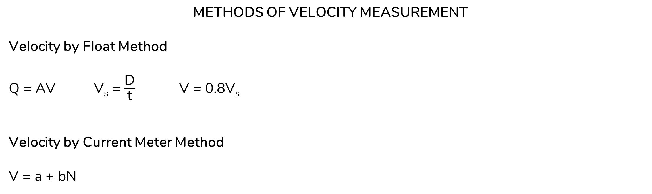
METHODS OF VELOCITY MEASUREMENT
Velocity by Float Method
Q = AV V_{s} = $\frac{\text{D}}{\text{t}}$ V = 0.8V_{s}
Velocity by Current Meter Method
V = a + bN
where: a = starting velocity
b = proportionality constant
N = speed of impeller
Reference: https://www.usgs.gov/faqs/what-groundwater
ATTRTC ABELE Review 2024
ATTRC ABELE Review 2025
Irrigation and Drainage Engineering | Open Channel
Irrigation and Drainage Engineering | Open Channel

Slide 34
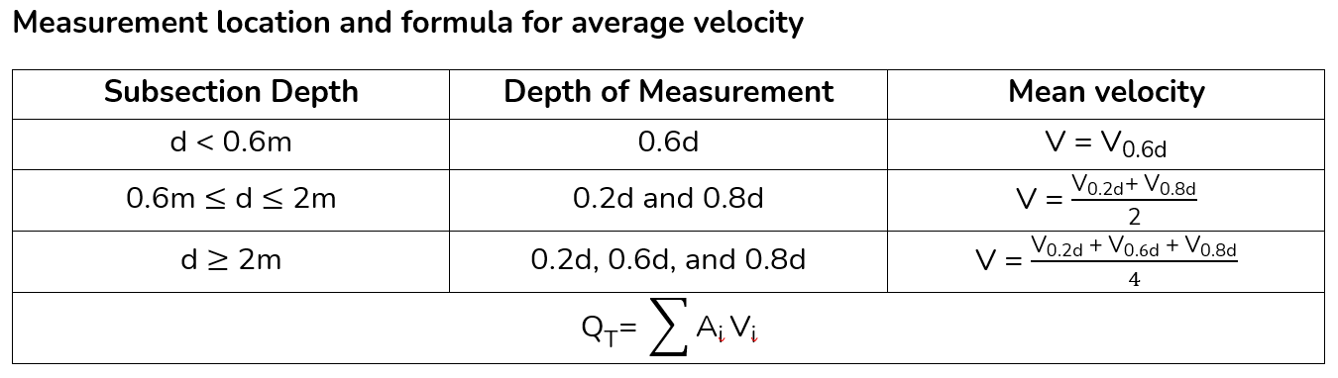
METHODS OF VELOCITY MEASUREMENT
Velocity by Float Method
Q = AV V_{s} = $\frac{\text{D}}{\text{t}}$ V = 0.8V_{s}
Velocity by Current Meter Method
V = a + bN
where: a = starting velocity
b = proportionality constant
N = speed of impeller
Reference: https://www.usgs.gov/faqs/what-groundwater
ATTRTC ABELE Review 2024
ATTRC ABELE Review 2025
Irrigation and Drainage Engineering | Open Channel
Irrigation and Drainage Engineering | Open Channel

Slide 35
METHODS OF VELOCITY MEASUREMENT
Velocity by Current Meter Method
V = a + bN
Reference: https://www.usgs.gov/faqs/what-groundwater
ATTRTC ABELE Review 2024
ATTRC ABELE Review 2025
Irrigation and Drainage Engineering | Open Channel
Irrigation and Drainage Engineering | Open Channel

Slide 36
QUESTION
Using the float method in determining the velocity of water in a channel, the float velocity in relation to the average water velocity is ____.
Equal to average water velocity
Less than to average water velocity
Greater than average water velocity
No relation at all
Reference: https://www.usgs.gov/faqs/what-groundwater
ATTRTC ABELE Review 2024
ATTRC ABELE Review 2025
Irrigation and Drainage Engineering | Open Channel
Irrigation and Drainage Engineering | Open Channel

Slide 37
QUESTION
The velocities at 0.2 and 0.8 of the depth of flow in a 1.0 m wide rectangular open channel are 1.2 m/s and 0.3 m/s respectively. If the flow depth is 0.8m, the discharge is?
Ans.: 0.6m3/s
Reference: https://www.usgs.gov/faqs/what-groundwater
ATTRTC ABELE Review 2024
ATTRC ABELE Review 2025
Irrigation and Drainage Engineering | Open Channel
Irrigation and Drainage Engineering | Open Channel

Slide 38
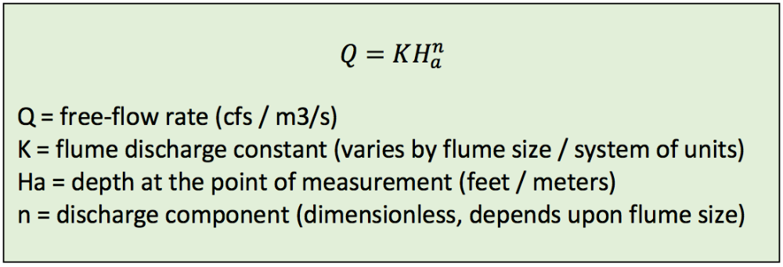
METHODS OF VELOCITY MEASUREMENT
Parshall Flume
Measures flow by noting the head loss caused by forcing a stream of water through a throat or constricted section of the flume with a depressed bottom.
Reference: https://www.usgs.gov/faqs/what-groundwater
ATTRTC ABELE Review 2024
ATTRC ABELE Review 2025
Irrigation and Drainage Engineering | Open Channel
Irrigation and Drainage Engineering | Open Channel

Slide 39

Velocity by Orifice Opening
V = $\sqrt{\text{2}\text{gh}}$ where: h = depth of water (cm) above opening
Q = C_{d}AV where: Cd value ranges from 0.027 to 0.035, depending on the position of orifice
Sharp Crested Weirs
Rectangular weir (Francis weir) Q = 0.0184LH^{3/2}
Rectangular weir with contraction Q = 0.0184(L – 0.2H)H^{3/2}
Trapezoidal weir (Cipoletti weir) Q = 0.0186LH^{3/2}
90⁰ triangular weir Q = 0.0138H^{5/2}
Where: Q = discharge (lps)
L = width of weir (cm)
H = total head (cm)
Reference: https://www.usgs.gov/faqs/what-groundwater
ATTRTC ABELE Review 2024
ATTRC ABELE Review 2025
Irrigation and Drainage Engineering | Open Channel
Irrigation and Drainage Engineering | Open Channel

Slide 40
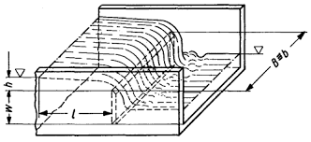
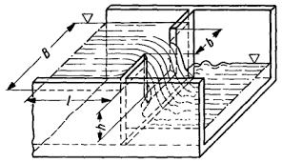
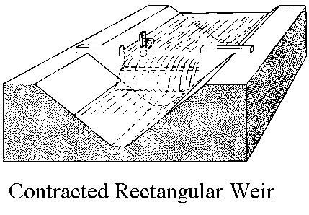
WEIRS
Q = CLH^{m}
Where: Q – discharge
C – coefficient, dependent on the nature of the crest and approach conditions.
L – length of crest
H – head of the crest
m – exponent, depending upon the weir opening
Reference: https://www.usgs.gov/faqs/what-groundwater
ATTRTC ABELE Review 2024
ATTRC ABELE Review 2025
Irrigation and Drainage Engineering | Open Channel
Irrigation and Drainage Engineering | Open Channel
Notes:
A weir is a barrier across the width of a river that alters the flow characteristics of water and usually results in a change in the height of the river level. They are also used to control the flow of water for outlets of lakes, ponds, and reservoirs.
A weir is a notch of regular form through which the water/irrigation stream is made to flow. The notch may be rectangular, trapezoidal, or triangular.
In the context of weirs, contractions refer to restrictions in the flow width, either due to the geometry of the weir opening or the channel. End contraction occurs when the weir does not span the full width of the channel, resulting in a smaller effective flow width. Contractions impact the flow rate by changing how water accelerates as it approaches the weir, which is crucial for accurate discharge calculations.

Slide 41
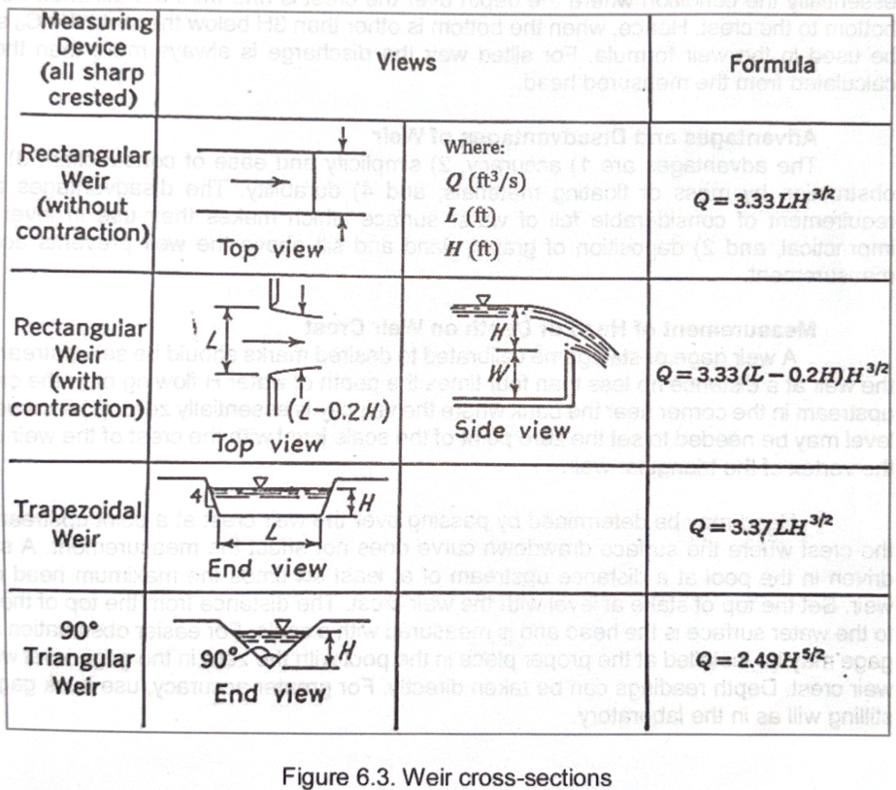
Where: Q = discharge (cfs)
L = width of weir (f)
H = total head (f)
Reference: https://www.usgs.gov/faqs/what-groundwater
ATTRTC ABELE Review 2024
ATTRC ABELE Review 2025
Irrigation and Drainage Engineering | Open Channel
Irrigation and Drainage Engineering | Open Channel

Slide 42
QUESTION
The theoretical flow velocity in an orifice is 4 m/s, what is the height of water flowing the center of the orifice?
Ans.: 0.82m
Reference: https://www.usgs.gov/faqs/what-groundwater
ATTRTC ABELE Review 2024
ATTRC ABELE Review 2025
Irrigation and Drainage Engineering | Open Channel
Irrigation and Drainage Engineering | Open Channel
Notes:
V = sqr 2gh

Slide 43
QUESTION
A rectangular lined canal will be used to irrigate 60 has. If a Francis weir of 0.4m crest will be used to control the flow, what would be the depth of water over the crest in order to supply 2 lps/ha?
Answers: h = 0.30m
Reference: https://www.usgs.gov/faqs/what-groundwater
ATTRTC ABELE Review 2024
ATTRC ABELE Review 2025
Irrigation and Drainage Engineering | Open Channel
Irrigation and Drainage Engineering | Open Channel
Notes:
Q = 0.0184LH^{3/2}

Slide 44
QUESTION
If the canal in the previous condition is changed into a triangular canal, what would be the depth of water over the crest if a V-notch weir is used?
Answers: h = 0.38m
Reference: https://www.usgs.gov/faqs/what-groundwater
ATTRTC ABELE Review 2024
ATTRC ABELE Review 2025
Irrigation and Drainage Engineering | Open Channel
Irrigation and Drainage Engineering | Open Channel
Notes:
Q = 0.0138H^{5/2}

Slide 45
QUESTION
What is the depth of water flowing on a 90⁰ V-notch weir if the water cross-sectional area is 0.5 m2?
Answers: y = 0.71m
Reference: https://www.usgs.gov/faqs/what-groundwater
ATTRTC ABELE Review 2024
ATTRC ABELE Review 2025
Irrigation and Drainage Engineering | Open Channel
Irrigation and Drainage Engineering | Open Channel

Slide 46
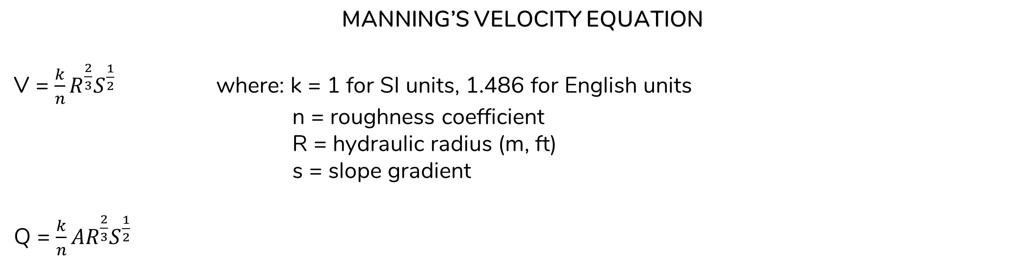
MANNING’S VELOCITY EQUATION
V = $\frac{k}{n}R^{\frac{2}{3}}S^{\frac{1}{2}}$ where: k = 1 for SI units, 1.486 for English units
n = roughness coefficient
R = hydraulic radius (m, ft)
s = slope gradient
Q = $\frac{k}{n}{AR}^{\frac{2}{3}}S^{\frac{1}{2}}$
Reference: https://www.usgs.gov/faqs/what-groundwater
ATTRTC ABELE Review 2024
ATTRC ABELE Review 2025
Irrigation and Drainage Engineering | Open Channel
Irrigation and Drainage Engineering | Open Channel

Slide 47
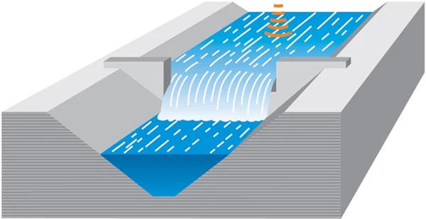
Open Channel Flow
An open channel is a waterway, canal or conduit in which a liquid flows with a free surface. It describes the
flow in rivers, man-made channels and partially-full pipes (sewers, drains), as well as the
behavior of hydraulic structures such as weirs, spillways and sluices.
Open channel is considered the most common method of conveying water for the irrigation.
Reference: https://www.sciencedirect.com/book/9780750659789/hydraulics-of-open-channel-flow
ATTRTC ABELE Review 2024
ATTRC ABELE Review 2025
Irrigation and Drainage Engineering | Open Channel
Irrigation and Drainage Engineering | Open Channel

Slide 48
QUESTION
This refers to a channel built with unvarying cross-section and constant bottom slope.
Open channel
Open conduits
Prismatic channel
Non-prismatic channel
- the cross-section is non-uniform or the bottom slope is not constant. Natural
channels are usually non-prismatic channel.
Reference: https://www.usgs.gov/faqs/what-groundwater
ATTRTC ABELE Review 2024
ATTRC ABELE Review 2025
Irrigation and Drainage Engineering | Open Channel
Irrigation and Drainage Engineering | Open Channel

Slide 49
QUESTION
When the water level in the pipe drops below the upper edge of the pipe or culvert and its conduit controls, the flow becomes:
Open channel
Open conduits
Prismatic channel
Non-prismatic channel
ATTRTC ABELE Review 2024
ATTRC ABELE Review 2025
Irrigation and Drainage Engineering | Open Channel
Irrigation and Drainage Engineering | Open Channel

Slide 50
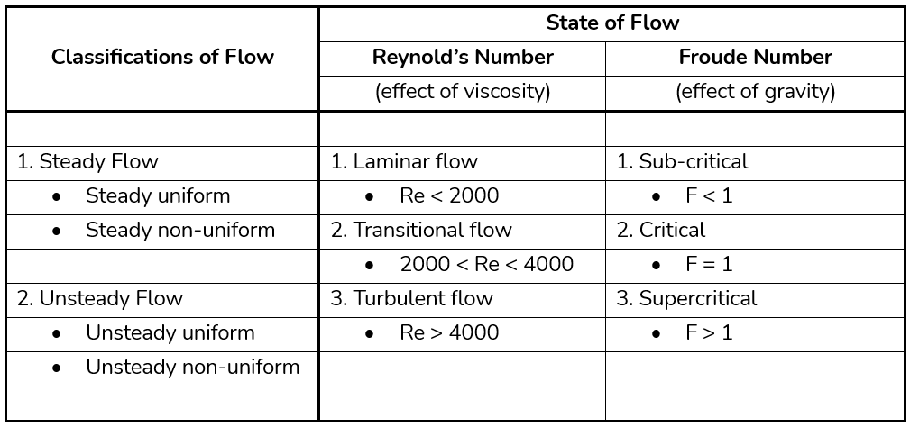
RECALL
ATTRTC ABELE Review 2024
ATTRC ABELE Review 2025
Irrigation and Drainage Engineering | Open Channel
Irrigation and Drainage Engineering | Open Channel

Slide 51
RECALL
The most simple form of open channel flow computation.
ATTRTC ABELE Review 2024
ATTRC ABELE Review 2025
Irrigation and Drainage Engineering | Open Channel
Irrigation and Drainage Engineering | Open Channel

Slide 52
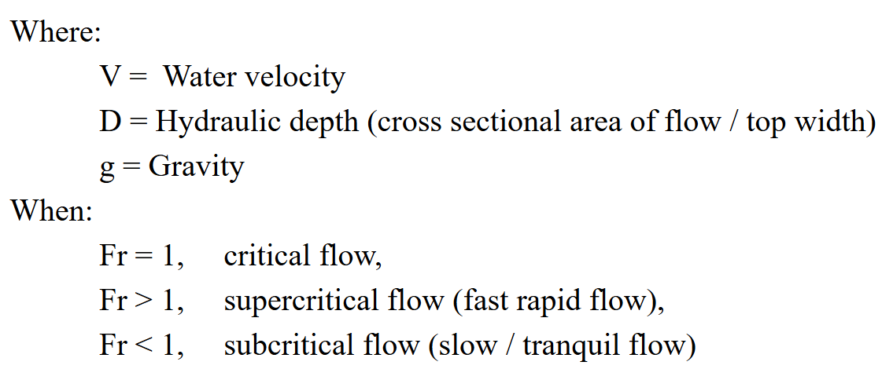
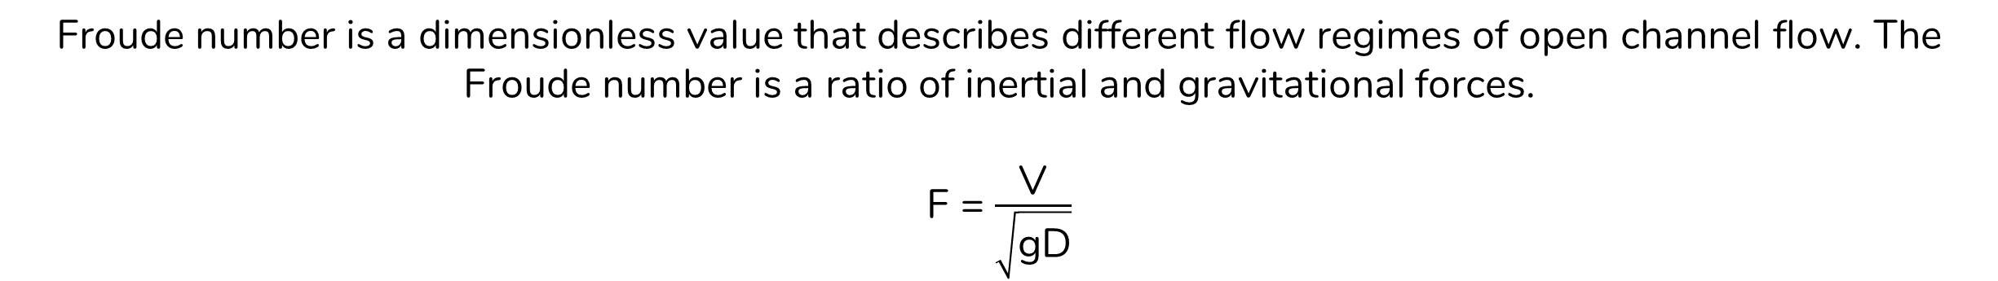
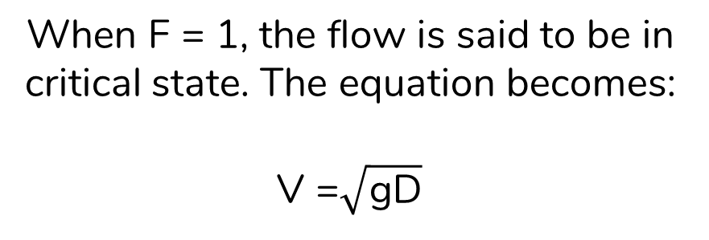
FROUDE NUMBER
Froude number is a dimensionless value that describes different flow regimes of open channel flow. The Froude number is a ratio of inertial and gravitational forces.
F = $\frac{\text{V}}{\sqrt{\text{gD}}}$
When F = 1, the flow is said to be in critical state. The equation becomes:
V =$\sqrt{\text{gD}}$
Reference: https://www.fsl.orst.edu/geowater/FX3/help/8_Hydraulic_Reference/Froude_Number_and_Flow_States.htm
ATTRTC ABELE Review 2024
ATTRC ABELE Review 2025
Irrigation and Drainage Engineering | Open Channel
Irrigation and Drainage Engineering | Open Channel

Slide 53
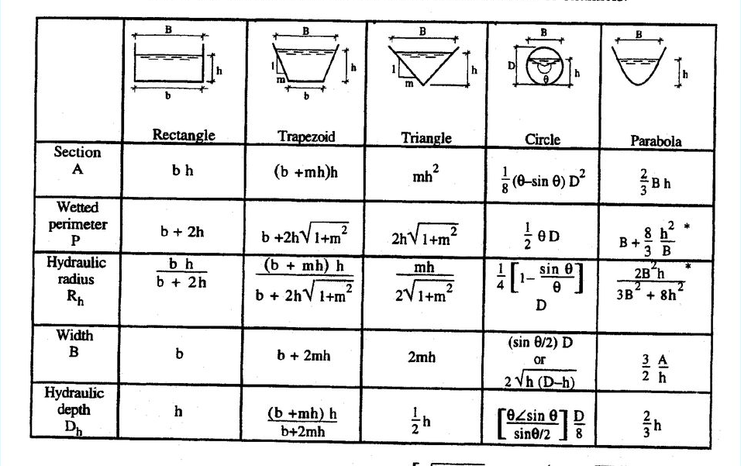
OPEN CHANNEL HYDRAULICS
Geometric elements for channel cross sections
Reference: https://www.fsl.orst.edu/geowater/FX3/help/8_Hydraulic_Reference/Froude_Number_and_Flow_States.htm
ATTRTC ABELE Review 2024
ATTRC ABELE Review 2025
Irrigation and Drainage Engineering | Open Channel
Irrigation and Drainage Engineering | Open Channel

Slide 54
Important Terminologies
Channel section refers to the cross section of a channel taken normal to the direction of flow.
Depth of flow, y is the vertical distance of the lowest point of a channel section from the free surface (or depth of flow section, d)
Stage is the elevation or vertical distance of the free surface above a datum. If the lowest point of the channel section is chosen as the datum, the stage is identical with the depth of flow.
Top width, T is the width of channel section at the free surface.
Water area, A - is the cross-sectional area of the flow normal to the direction of flow.
Wetted perimeter, P is the length of the line of intersection of the channel wetted surface with a cross-sectional plane normal to the direction of flow.
Hydraulic radius, R is the ratio of the cross sectional area to the wetted perimeter
Reference: https://www.sciencedirect.com/book/9780750659789/hydraulics-of-open-channel-flow
ATTRTC ABELE Review 2024
ATTRC ABELE Review 2025
Irrigation and Drainage Engineering | Open Channel
Irrigation and Drainage Engineering | Open Channel

Slide 55
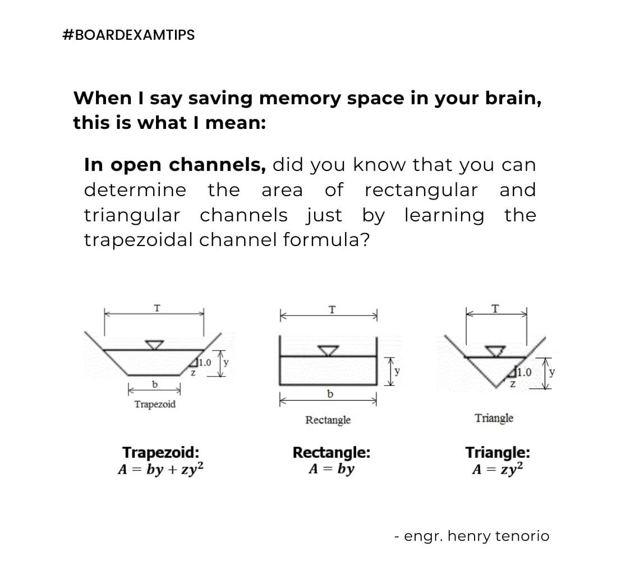
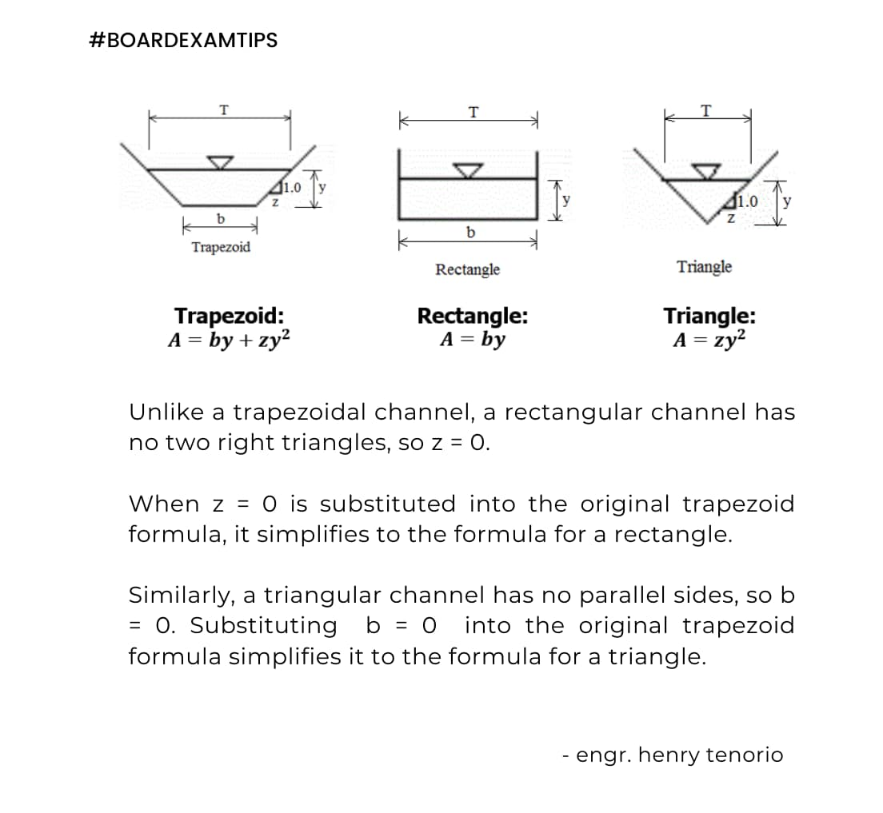
ATTRTC ABELE Review 2024
ATTRC ABELE Review 2025
Irrigation and Drainage Engineering | Open Channel
Irrigation and Drainage Engineering | Open Channel

Slide 56
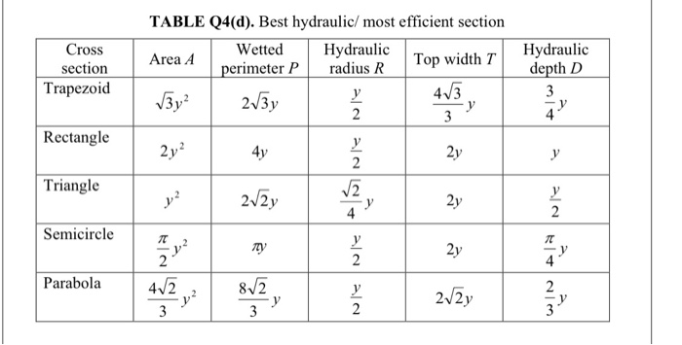
OPEN CHANNEL HYDRAULICS
Best hydraulic section
half of a perfect hexagon
half of a square
half of a square
Reference: https://www.fsl.orst.edu/geowater/FX3/help/8_Hydraulic_Reference/Froude_Number_and_Flow_States.htm
ATTRTC ABELE Review 2024
ATTRC ABELE Review 2025
Irrigation and Drainage Engineering | Open Channel
Irrigation and Drainage Engineering | Open Channel

Slide 57
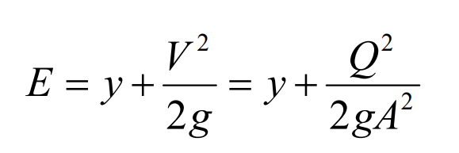
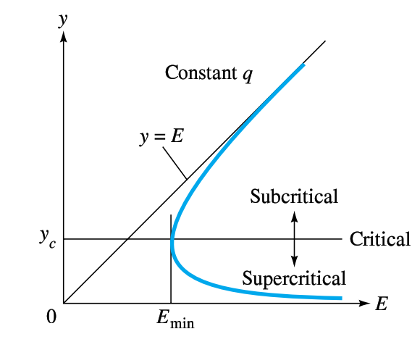

SPECIFIC ENERGY AND CRITICAL FLOW
Specific energy is the sum of the depth of flow and the velocity head. Specific energy at a cross-section is:
Critical Flow In Open Channels
When the flow is at critical depth, the Froude number is equal to 1. This gives the following equality below, relating the area and top width of flow to the discharge of the channel and gravity.
A = area (m², ft²)
T = top width (m, ft)
Q = discharge (m³/s, cfs)
g = gravity (9.81m/s², 32.2fps)
If y_{actual} > y_{critical}, flow is subcritical
If y_{actual} < y_{critical}, flow is supercritical
Reference: https://www.fsl.orst.edu/geowater/FX3/help/8_Hydraulic_Reference/Froude_Number_and_Flow_States.htm
ATTRTC ABELE Review 2024
ATTRC ABELE Review 2025
Irrigation and Drainage Engineering | Open Channel
Irrigation and Drainage Engineering | Open Channel

Slide 58

QUESTION
What is the depth of water in a trapezoidal channel with a side slope of 2 and carrying a 2.5 m3/s water flow? The channel’s bottom width is 1.5 meters and the flowing water has a velocity of 0.8 m/s.
Ans.: 0.93m
Q = AV
A = $\frac{\text{Q}}{\text{V}}$ = $\frac{\text{2.5}\text{m}\text{3/}\text{s}}{\text{0.8}\text{m}\text{/}\text{s}}$ = 3.125m2
3.125 = (b + mh)h
3.125 = (1.5 + 2h)h
By shift solve:
h = 0.93m
ATTRTC ABELE Review 2024
ATTRC ABELE Review 2025
Irrigation and Drainage Engineering | Open Channel
Irrigation and Drainage Engineering | Open Channel

Slide 59


QUESTION
Consider a farm irrigation canal having the following dimensions: bottom width of 0.50 meters, total depth of 0.65 meters, side slopes of 2:1, depth of water of 0.50 meter, and channel slope of 1 meter per kilometer. Use n = 0.024. Determine the ff: cross-sectional area of the stream, wetted perimeter, hydraulic radius, and the discharge of the stream.
Answers: A = 0.75m²
P = 2.74m
R = 0.27m
Q = 0.41m³/s
A = (b + mh)h
A = [0.5 + 2(0.5)]0.5
A = 0.75m²
P = b + 2h$\sqrt{1+m^{2}}$
P = 0.5 + 2(0.5)$\sqrt{1+2^{2}}$
P = 2.74m
R = A/P
R = 0.75/2.74
R = 0.27m
Q = $\frac{1}{n}$A${\text{R}}^{\frac{2}{3}}{\text{S}}^{\frac{1}{2}}$
Q = $\frac{1}{0.024}(0.75){(0.27)}^{\frac{2}{3}}{\text{(1/1000)}}^{\frac{1}{2}}$
Q = 0.41m³/s
ATTRTC ABELE Review 2024
ATTRC ABELE Review 2025
Irrigation and Drainage Engineering | Open Channel
Irrigation and Drainage Engineering | Open Channel

Slide 60

QUESTION
A triangular channel section with a bottom angle 80 deg with channel gradient 0.0016 and n = 0.025, carries a discharge of 400 cfs, determine the normal depth and the velocity of flow.
Slope, m = H/V
tan(40) = opp/adj = H/V
tan(40) = 0.84 = m
Answers: y = 9.68ft
V = 5.08fps
40°
V
Q = $\frac{1.486}{n}$A${\text{R}}^{\frac{2}{3}}{\text{S}}^{\frac{1}{2}}$
Q = $\frac{1.486}{n}(mh^{2}){\left(\frac{mh^{2}}{\text{2}\text{h}\sqrt{1+m^{2}}}\right)}^{\frac{2}{3}}{\text{(}\text{S}\text{)}}^{\frac{1}{2}}$
400cfs = $\frac{1.486}{0.025}(0.84h^{2}){\left(\frac{0.84h^{2}}{\text{2}\text{h}\sqrt{1+{0.84}^{2}}}\right)}^{\frac{2}{3}}{\text{(}\text{0.0016}\text{)}}^{\frac{1}{2}}$
By shift solve:
h = y = 9.68ft
H
40°
40°
Q = AV
V = Q/A
V = 400cfs/[0.84(9.68²)]
V = 5.08fps
ATTRTC ABELE Review 2024
ATTRC ABELE Review 2025
Irrigation and Drainage Engineering | Open Channel
Irrigation and Drainage Engineering | Open Channel

Slide 61

QUESTION
Given a trapezoidal canal with cross-sectional area of 20 ft²; for best hydraulic section, what should be the depth of flow and the bottom width of the channel?
TAKE NOTE: for best trapezoidal section, m = 0.577
Answers: y = 3.4ft
A = 20ft² = $\sqrt{3}$y²
y = 3.4ft
A = (b + mh)h
20 = [b + 0.577(.4)]3.4
b = 3.92ft
ATTRTC ABELE Review 2024
ATTRC ABELE Review 2025
Irrigation and Drainage Engineering | Open Channel
Irrigation and Drainage Engineering | Open Channel

Slide 62
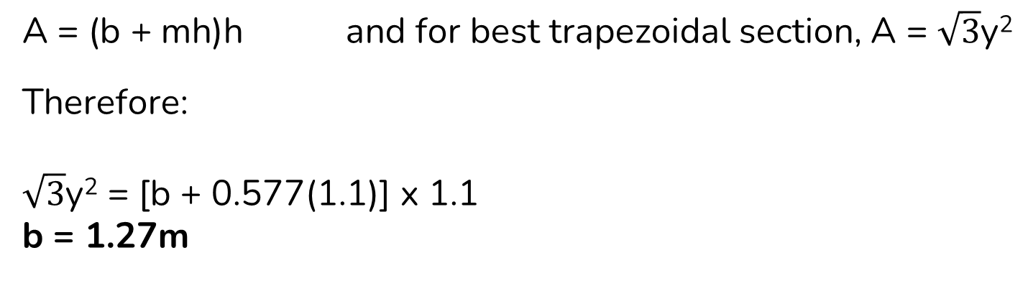

QUESTION
The most hydraulically efficient trapezoidal channel section to carry a discharge of 5m3/s on a bed material with a roughness n of 0.02 and a bottom slope of 1 in 200 should have a bottom width of?
Answers: b = 1.27m
Q = $\frac{1}{n}$A${\text{R}}^{\frac{2}{3}}{\text{S}}^{\frac{1}{2}}$
Q = $\frac{1}{n}\left(\sqrt{3}\text{y}\text{2}\right){\left(\frac{y}{2}\right)}^{\frac{2}{3}}{\left(S\right)}^{\frac{1}{2}}$
5 = $\frac{1}{0.02}\left(\sqrt{3}\text{y}\text{2}\right){\left(\frac{y}{2}\right)}^{\frac{2}{3}}{\left(\frac{1}{200}\right)}^{\frac{1}{2}}$
By shift solve:
y = 1.1
A = (b + mh)h and for best trapezoidal section, A = $\sqrt{3}$y²
Therefore:
$\sqrt{3}$y² = [b + 0.577(1.1)] x 1.1
b = 1.27m
ATTRTC ABELE Review 2024
ATTRC ABELE Review 2025
Irrigation and Drainage Engineering | Open Channel
Irrigation and Drainage Engineering | Open Channel

Slide 63

QUESTION
A concrete-lined trapezoidal canal is to carry a maximum discharge of 2.0 m3/s. The required head loss over a horizontal distance of 1 km is 2.0 m. The side slope is to be set at 1:1 and the permissible b/d ratio is 3. If the Manning’s roughness coefficient is 0.015, the design depth required is?
Given: b/d = 3 or b/h = 3
Therefore, b can be expressed in terms of h. We can rewrite it as b = 3h.
Replacing all b values to 3h, we have
Answers: y = 0.56m
Q = $\frac{1}{n}$A${\text{R}}^{\frac{2}{3}}{\text{S}}^{\frac{1}{2}}$
Q = $\frac{1}{n }\left[bh+{mh}^{2}\right]{\left(\frac{bh+{mh}^{2}}{\text{b}\text{ + }\text{2}\text{h}\sqrt{1+m^{2}}}\right)}^{\frac{2}{3}}{\left(S\right)}^{\frac{1}{2}}$
2 = $\frac{1}{0.015}\left[\left(3h\right)h+h^{2}\right]{\left(\frac{3h2+ h^{2}}{\text{3}\text{h}\text{ + }\text{2}\text{h}\sqrt{1+1^{2}}}\right)}^{\frac{2}{3}}{\left(\frac{2}{1000}\right)}^{\frac{1}{2}}$
By shift solve:
y = 0.56m
ATTRTC ABELE Review 2024
ATTRC ABELE Review 2025
Irrigation and Drainage Engineering | Open Channel
Irrigation and Drainage Engineering | Open Channel

Slide 64
THANK YOU
ABELE | 2025
ATTRTC - Iligan City

